Slide 1



OBJECTION DETECTION USING YOLOV8
Presented By,
Loga Priya S (811722104081)
Priyadharshini A (811722104115)
Riffa Infee R R (811722104123)
Guided By,
Mrs. A. S.GAYATHRI.M.E.,
DD/MM/YYYY

Slide 2
ABSTRACT
Utilizes YOLOv8 for high-speed, high-accuracy object detection.
Trained on a custom dataset featuring multiple object classes.
Supports real-time detection in images and video streams.
Offers practical use cases in security, automation, and smart environments.
Demonstrates the integration of AI with computer vision for real-world problem-solving.
DD/MM/YYYY

Slide 3
OBJECTIVE
To develop a real-time object detection desktop application using YOLOv8.
Detect objects from live webcam feed and highlight them with bounding boxes.
Provide a user-friendly interface with buttons to start and stop detection.
Implement fast, accurate, and lightweight object detection for real-world applications.
DD/MM/YYYY

Slide 4
LITERATURE SURVEY
S.No. | Paper Title | Year | Remark
1 | You Only Look Once: Unified, Real-Time Object Detection – Joseph Redmon et al. | 2016 | Introduced YOLO, enabling real-time object detection with a single CNN.
2 | YOLOv4: Optimal Speed and Accuracy of Object Detection – Alexey Bochkovskiy et al. | 2020 | Improved YOLO performance using CSPDarknet and better training strategies.
3 | YOLOv5 by Ultralytics | 2020 | Offered easy implementation and custom training with PyTorch backend.
DD/MM/YYYY

Slide 5
LITERATURE SURVEY
S.No. | Paper Title | Year | Remark
4 | YOLOv8 – Ultralytics Documentation and Benchmark Results | 2023 | Latest YOLO version with improved accuracy, lightweight architecture, and support for segmentation, detection, and classification.
5 | Faster R-CNN: Towards Real-Time Object Detection with Region Proposal Networks – Shaoqing Ren et al. | 2015 | Proposed a two-stage object detector with improved accuracy but slower speed.
6 | SSD: Single Shot MultiBox Detector – Wei Liu et al. | 2016 | Offered a single-shot detection model faster than Faster R-CNN with good accuracy.
DD/MM/YYYY

Slide 6
LITERATURE SURVEY
S.No. | Paper Title | Year | Remark
7 | YOLO9000: Better, Faster, Stronger – Joseph Redmon & Ali Farhadi | 2017 | Enhanced YOLO with multi-label detection and classification over 9000 classes.
8 | EfficientDet: Scalable and Efficient Object Detection – Mingxing Tan et al. | 2020 | Introduced a model that balances accuracy and computational cost effectively.
9 | YOLOv3: An Incremental Improvement – Joseph Redmon & Ali Farhadi | 2018 | Improved accuracy over YOLOv2 with better backbone (Darknet-53) and multi-scale detection.
DD/MM/YYYY

Slide 7
EXISTING SYSTEM
YOLO (You Only Look Once) Series
Real-time object detection models (YOLOv1 to YOLOv7) focused on speed and accuracy using one-stage detection.
Faster R-CNN & SSD
Two-stage and one-stage detectors respectively; provide high accuracy but often slower than YOLO for real-time use.
YOLOv5 (Ultralytics)
Widely used due to ease of training, deployment, and support for custom datasets.
OpenCV + Pretrained Models
Used for basic object detection tasks with limited flexibility for custom classes or real-time performance.
DD/MM/YYYY

Slide 8
PROPOSED SYSTEM
Custom Dataset Preparation: Collect and annotate images using tools like LabelImg or Roboflow in YOLO format for specific object categories.
Model Training with YOLOv8: Train the YOLOv8 model using PyTorch with optimized hyperparameters for high accuracy and speed.
Performance Evaluation: Assess the model using mAP, Precision, Recall, and IoU metrics to ensure detection quality.
Real-Time Detection: Implement live object detection using OpenCV and the trained model on image/video inputs or webcam feed.
DD/MM/YYYY

Slide 9
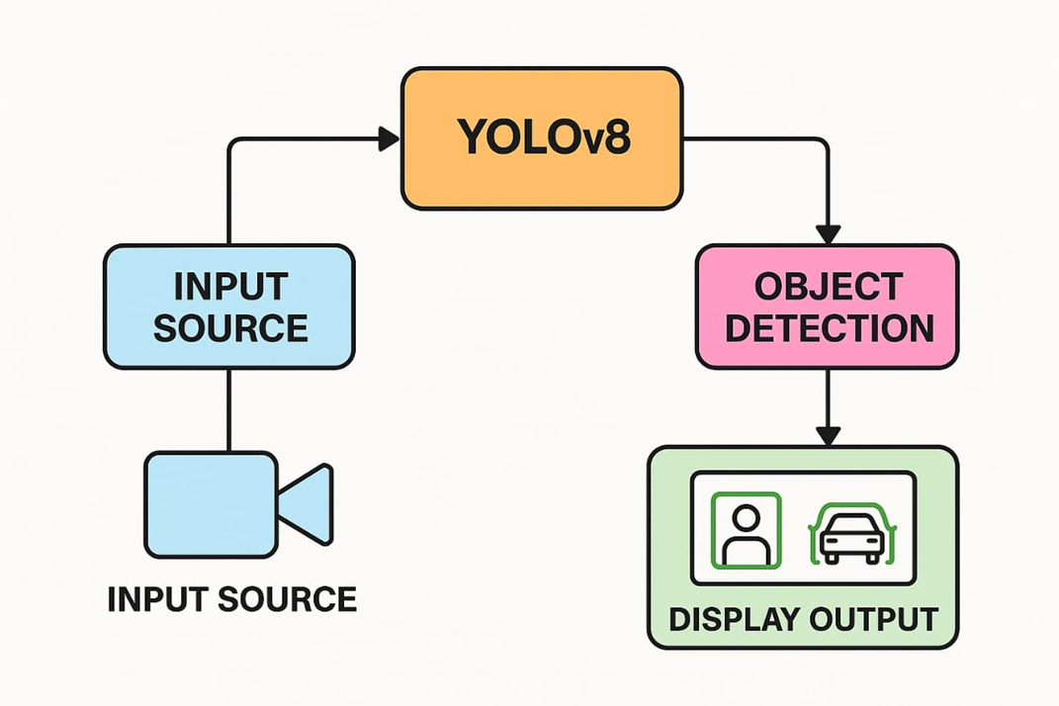
SYSTEM ARCHITECTURE
DD/MM/YYYY

Slide 10
MODULE 1 :Data Collection & Annotation
Collected images from real-world environments relevant to the use case.
Defined custom object classes (e.g., person, laptop, pen, etc.).
Used annotation tools (e.g., Roboflow, CVAT) to label objects in images.
Exported dataset in YOLO format for training.
DD/MM/YYYY

Slide 11
MODULE 2 :Model Training with YOLOv8
Used YOLOv8 for its speed, accuracy, and ease of customization.
Split data into training, validation, and testing sets.
Trained the model using Ultralytics YOLOv8 Python library.
Tuned hyperparameters (epochs, batch size, learning rate) for optimal performance.
DD/MM/YYYY

Slide 12
MODULE 3 :Model Evaluation & Testing
Evaluated the model using metrics like mAP, precision, and recall.
Tested object detection on images and live webcam feeds.
Verified detection accuracy across different lighting and angles.
Identified areas for improvement in detection performance.
DD/MM/YYYY

Slide 13
MODULE 4 :Deployment & Application
Deployed the trained model for real-time inference using OpenCV.
Designed basic UI to display detection results (bounding boxes, labels).
Integrated with live video input (e.g., webcam or IP camera).
Explored use cases: surveillance, object counting, smart inventory.
DD/MM/YYYY

Slide 14
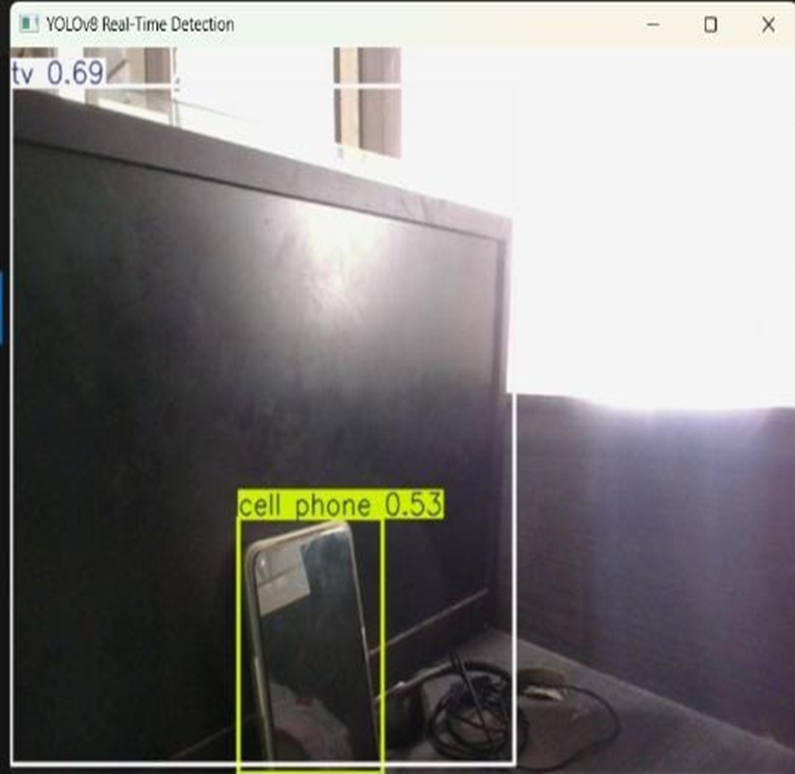
OUTPUT
DD/MM/YYYY

Slide 15
CONCLUSION & FUTURE ENHANCEMENT
Successfully implemented YOLOv8 for accurate, real-time object detection on a custom dataset.
Demonstrated applications in surveillance, smart environments, and item recognition.
Future work includes optimizing the model for edge devices and real-time camera integration.
Plans to enhance usability with a web/mobile interface, alert system, and cloud-based analytics.
DD/MM/YYYY

Slide 16
REFERENCES
Glenn Jocher, Ayush Chaurasia, Laughing Qian, and Jirka Borovec (2023). YOLOv8 Documentation. Ultralytics. Available at: https://docs.ultralytics.com
Glenn Jocher (2023). Ultralytics YOLOv8 GitHub Repository. Available at: https://github.com/ultralytics/ultralytics
Alexey Bochkovskiy, Chien-Yao Wang, and Hong-Yuan Mark Liao (2020). YOLOv4: Optimal Speed and Accuracy of Object Detection. arXiv:2004.10934
Joseph Redmon and Ali Farhadi (2018). YOLOv3: An Incremental Improvement. arXiv:1804.02767
DD/MM/YYYY

Slide 17

DD/MM/YYYY

